Slide 1
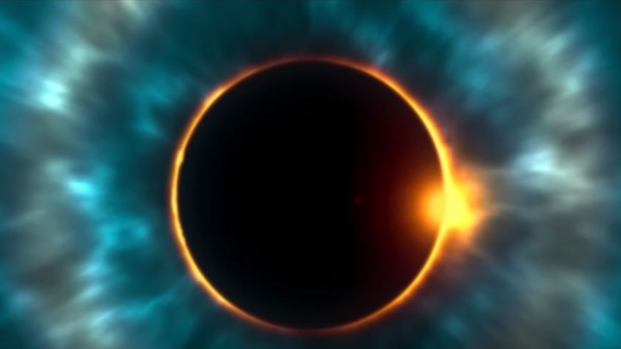
Solar Eclipse of 2017

Slide 2
What’s the big deal?

Slide 3
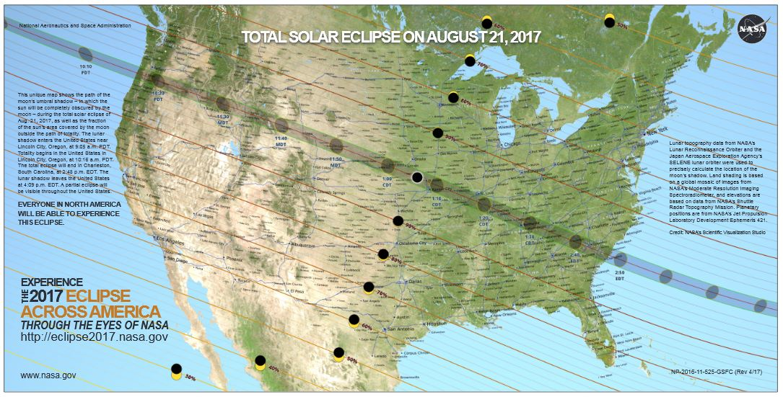

Slide 4
Does the eclipse mean anything?

Slide 5
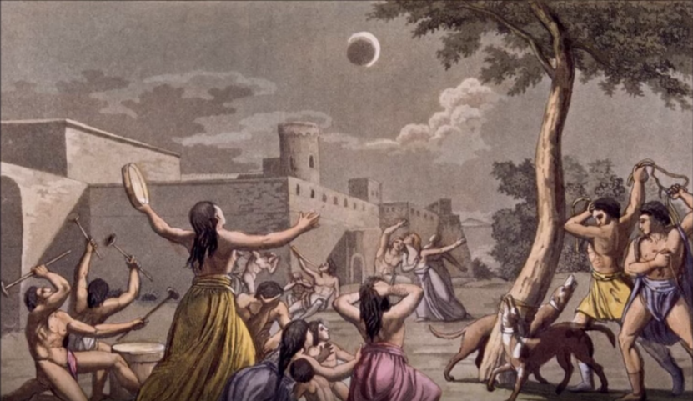
Uh, no…

Slide 6
What is an eclipse?
What types of eclipses occur?

Slide 7
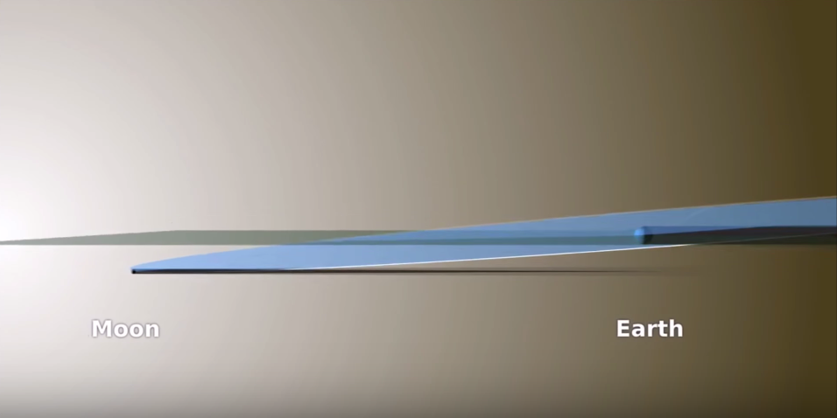
Moon’s orbit tilts 5 degrees (5º9’)
Sun

Slide 8
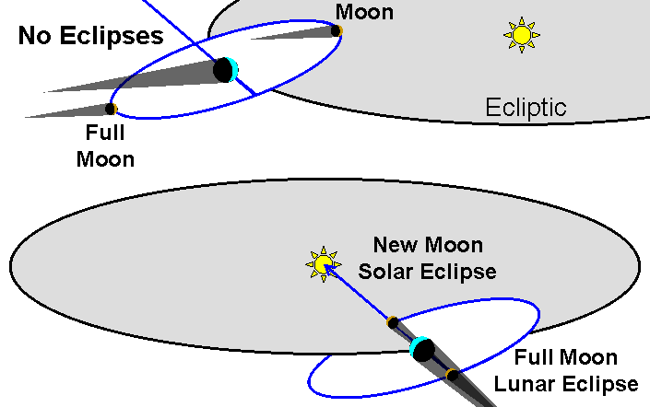

Slide 9
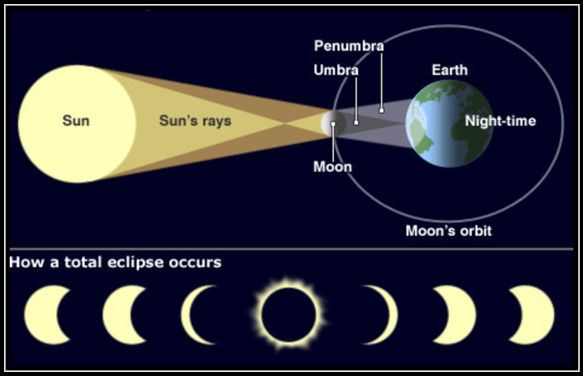

Slide 10
Total solar eclipse
Partial
solar eclipse
Annular
solar eclipse
Lunar
eclipse

Slide 11
Should you look at the eclipse?
Should you look at the eclipse?

Slide 12
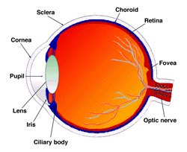
NO!
= dead bug!
= partial blindness!

Slide 13
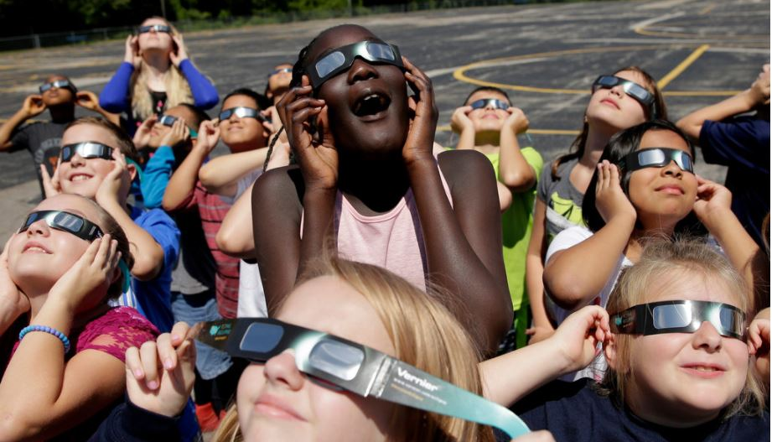

Slide 15
Should you snap a photo of the eclipse?

Slide 16
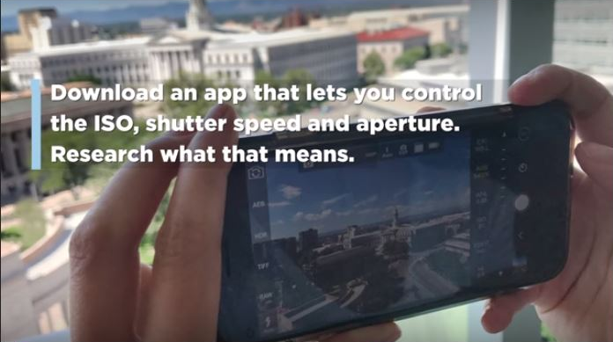

Slide 18
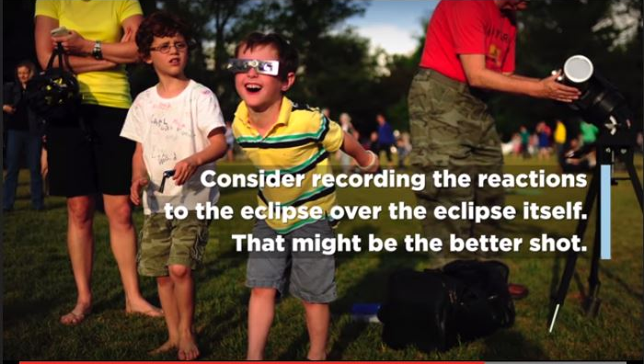

Slide 19
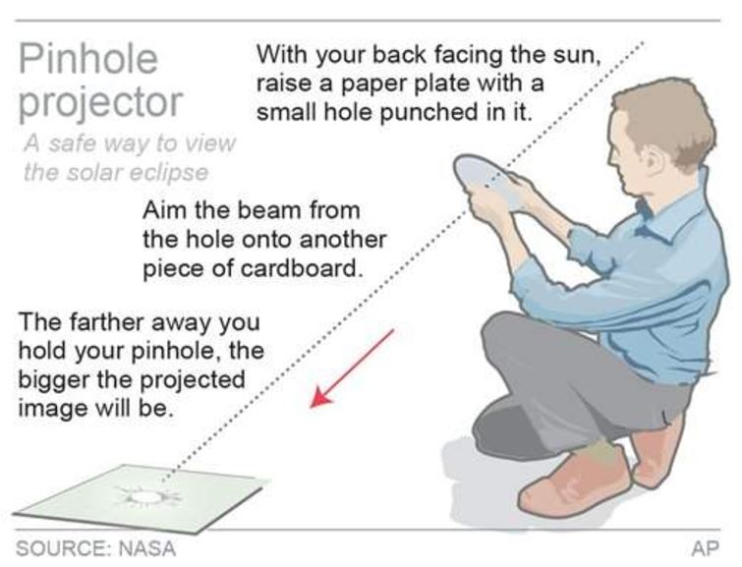
Other safe ways to view the eclipse:
--- the sun shining through leaves will creates 100s of eclipses
--- NASA streams it live at eclipse2017.nasa.gov
--- watch it projected by someone else’s telescope
--- photograph people’s reactions instead
--- watch how animals react to the eclipse

Slide 20
What is going to happen on Monday?

Slide 21
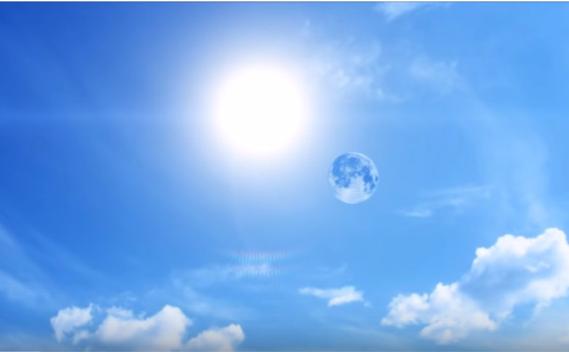

Slide 22
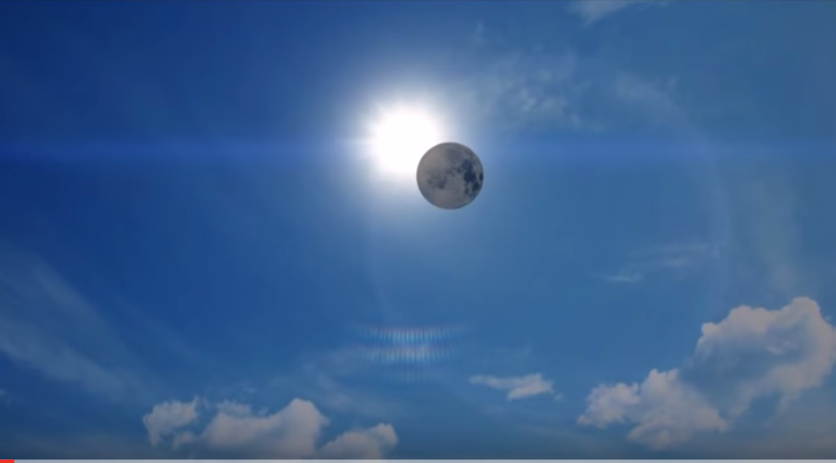

Slide 23
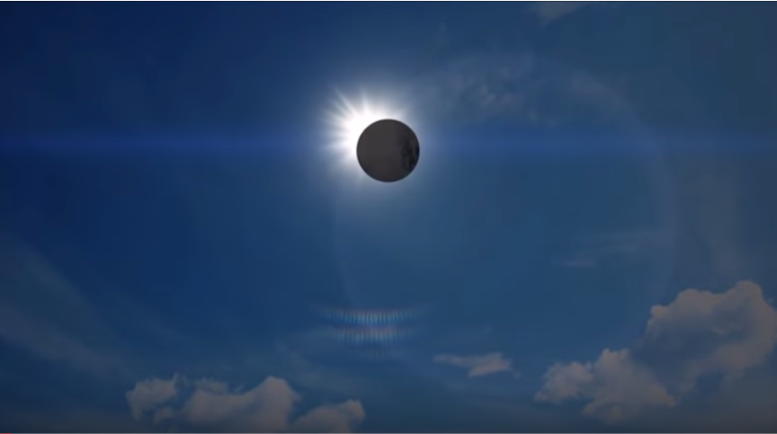

Slide 24
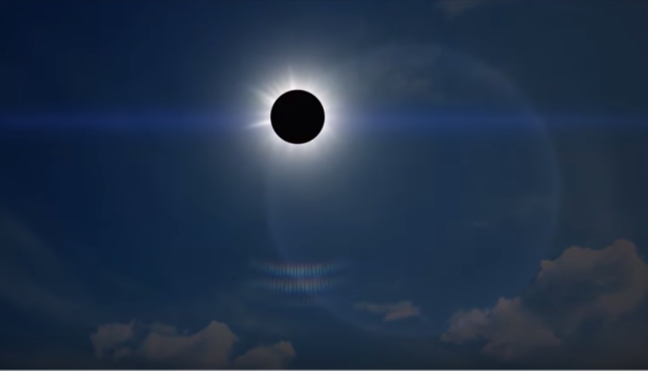

Slide 25
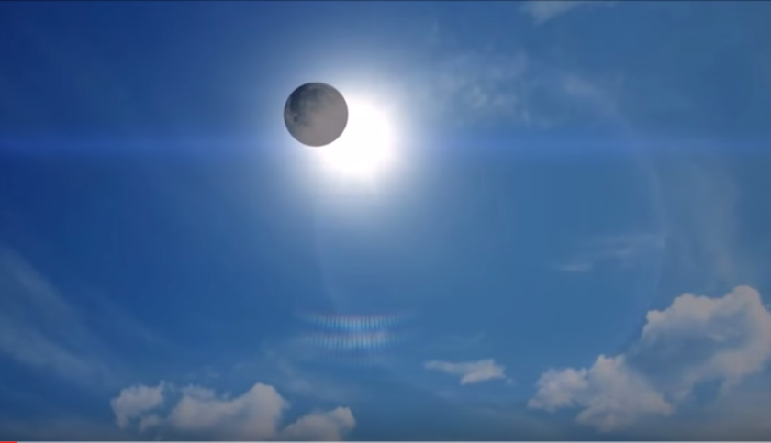

Slide 26
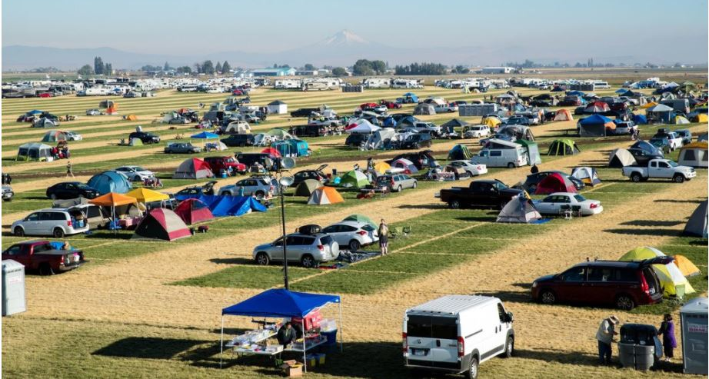

Slide 27
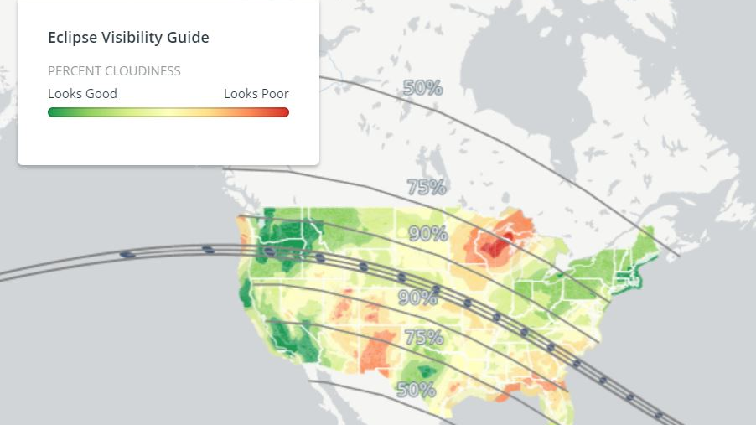

Slide 28
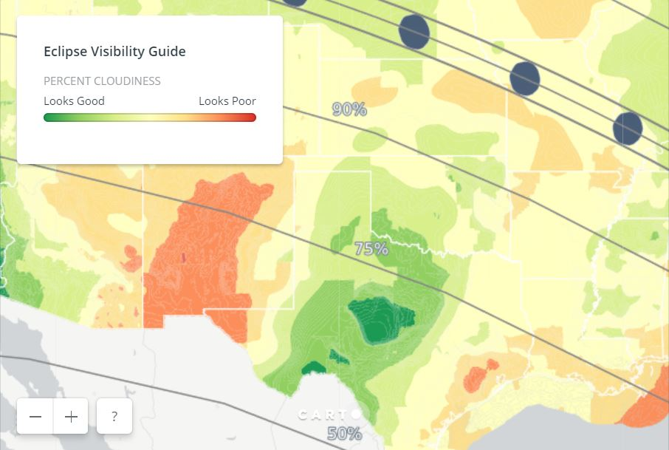

Slide 29
This is 75%

Slide 30
When will this happen again?

Slide 31
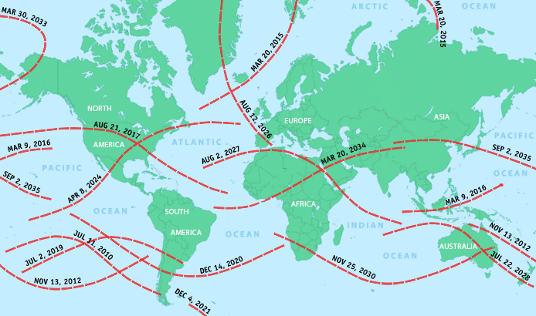
Total eclipses from 2010-2035

Slide 32
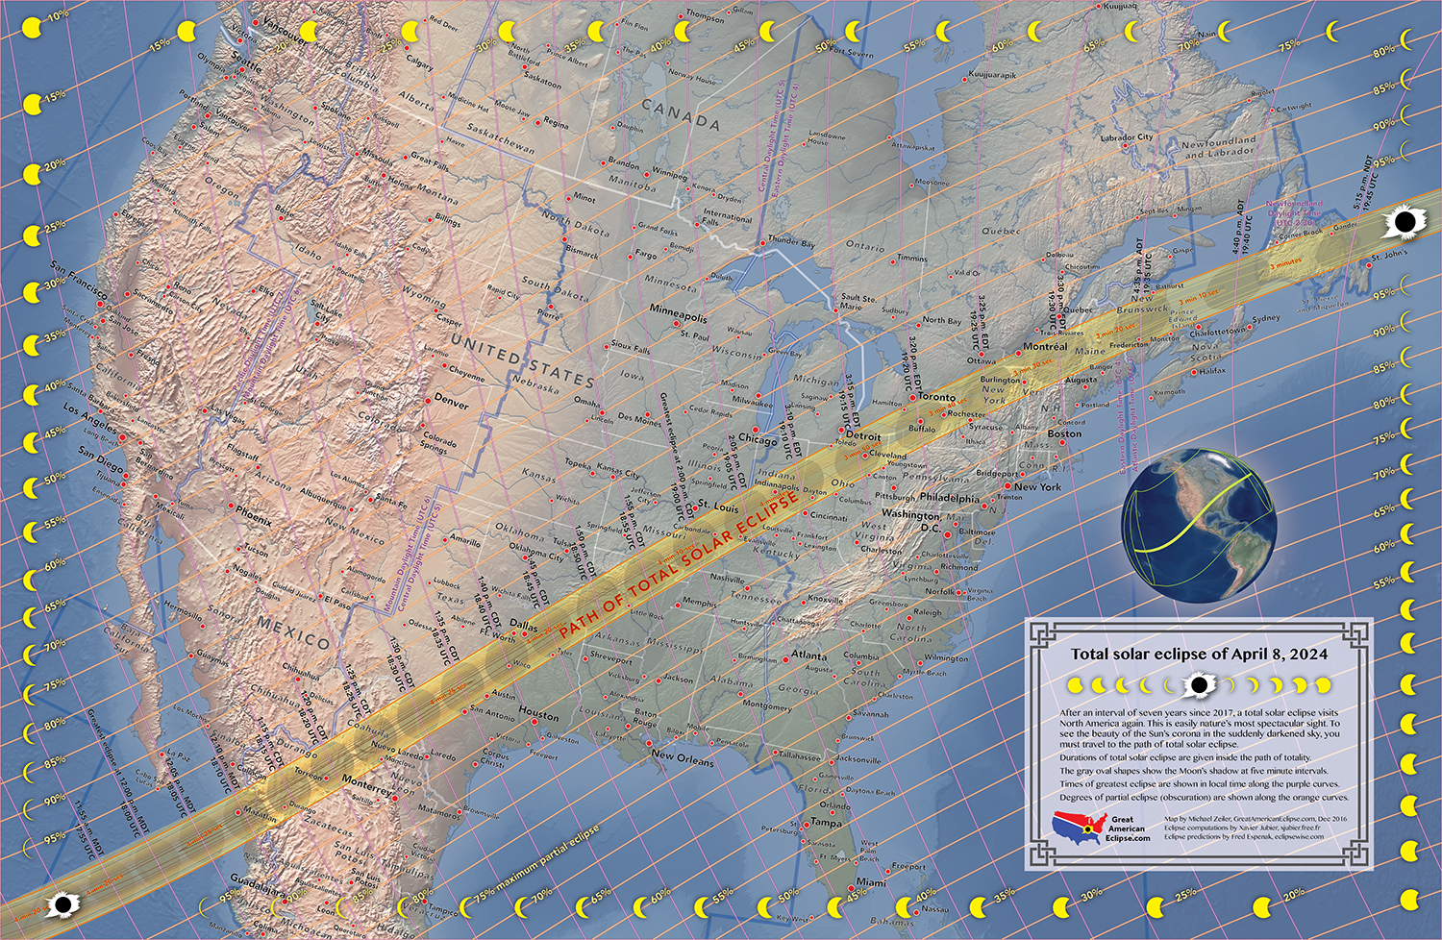

Slide 33
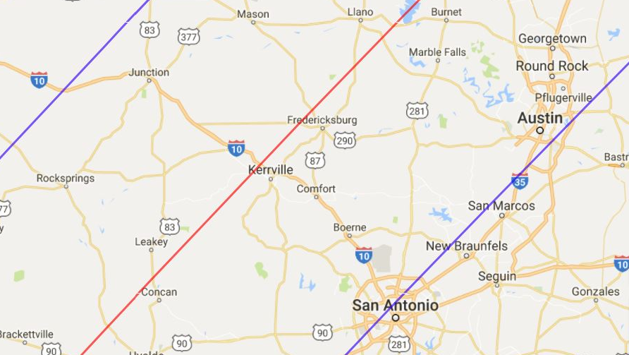
2024 – right over my house! ☺

Slide 34
Do some research to enjoy the experience more

Slide 35
https://eclipse2017.nasa.gov/
https://eclipse2017.nasa.gov/sites/default/files/interactive_map/index.html
https://www.exploratorium.edu/eclipse
https://www.exploratorium.edu/eclipse/ how-to-view-eclipse

Slide 36
